Slide 1




Annual Meeting
Programme Operator (PO)
European Economic Area Financial Mechanism 2009-2014
Programme Area:
«GR03 - Renewable Energy»
Athens, 4th November 2015

Slide 2
PO CRES Project Team
Board of Directors of CRES
General Director
Mr. Vasilis Kilias
Legal Services
Ms. Evaggelia Paleologou
Mr. Vasilis Baroutas
Project Manager
Mr. DAMASIOTIS Markos
Technical Coordinator
Dr. PATLITZIANAS Konstantinos
Existing Structures
in CRES
Subteam of Project Accession
Dr. Haralampos Malamatenios
Ms. Flora Stefanou
Selection Committee
Subteam of Supporting Actions
Ms. Aggeliki Lianou
Ms. Eleni Politi
Ms. Alexandra Katsouri
Ms. Kalliopi Pizania
Ms. Vasiliki Papadopoulou
Ms. Ioanna Papamihail
Subteam of Project Monitoring
Ms. Argiro Roinioti
Dr. George Stavrakakis
Ms. Eleni Hatzigeorgiou
Mr. Dionisis Papavasileiou
Dr. Sotiris Xepapas
Ms. Maria Tsarmpopoulou
Mr. Eleftherios Yakoumelos
Mr. George Linakis
Independent Reviewers
Objections Committee
Dr. Nikos Karapanagiotis
Mr. George Kanavakis
Mrs. Efi Korma
Subteam of Project Control
Dr. Nikos Stefanakis
Mr. Panagiotis Zorlos
Mr. Nikos Ntaras
Publicity Officer
Ms. Athina Paralika

Slide 3
GR03 – Summary of Current Status
The programme is implemented smoothly and on schedule.
The Management and Control System (MCS) is applied (after its last modification) ensuring the functionality of processes and risk minimization.
Emphasis is given on performing a thorough check of the tender documents in order to minimize the likelihood of appeals on tenders as well as possible delays.
The necessary permits and approvals have been received for all accessed projects.
Calls for tenders are expected to be published from next month onwards.
Targeted publicity actions are planned such as the Training Seminar on project monitoring for the Project Promoters (01/12/2015), during which the GR03 Programme will be presented to the media.
The bilateral funds will be transferred to Project Promoters for expertise sharing with bodies from donors countries.
Targeted complementary actions are planned in order to explore and enhance expertise sharing with other POs implementing programmes of similar nature.
The start of the bilateral programme on geothermal energy with the Orkustofnun Institute is awaited.

Slide 4
Outline
Status of programme implementation.
Horizontal concerns - Risk management.
Bilateral Fund – Complementary Actions.
Publicity & Communication.
Bilateral Programme CRES – Orkustofnun.

Slide 5
Status of Programme Implementation

Slide 6
Programme implementation: Progress
July 2015:
  PO CRES sent the draft Project Agreement to the Project Promoters, as well as the Technical Annex of the Project.
  The Project Promoters in turn, returned one copy of the Project Agreement along with the Project Technical Annex, signed by their legal representative.
  August 2015:
    The accession procedure was completed with the signing of the accession decisions for all 10 positively evaluated proposals, by the Minister of Environment and Energy on August 8th.
October 2015:
  The Minister of Economy, Development and Tourism approved the integration of Projects 1-7 in the National Investment Programme on October 15th.
September 2015 – to date:
  The Project Promoters have sent the tender documents, as instructed by PO CRES. The relevant tender documents are currently under review, in the context of the pre-approval process.

Slide 7
Programme implementation: Tender pre-approval
  The Project Promoter, before the tendering, submits to the PO a file with all the required documents for reviewing of the legality of the tendering procedure.
  The subgroup of Projects Audit performs a thorough check of the tender documents based on the current legal framework of the project, the EC and national rules of eligibility and the documents relevant with the Programme. The results of the audit are depicted in the “Tendering Stage Checking List”.
  PO CRES prepares the “Tender Pre-Approval”, on which the opinion of the Programme Operator CRES can be in agreement, conditionally in agreement or not in agreement.
  The tender pre-approval process started on September and is expected to be completed in November.

Slide 8
Accessed Projects of GR03 - Geography
Western Macedonia: 2
Eastern Macedonia & Thrace: 2
Central Greece: 1
Northern Aegean: 1
Attica: 2
Peloponnese: 1
Crete: 1

Slide 9
Accessed Projects of GR03 - Total
 | Potential Project Promoter | Title | Total proposed budget (€)
1. | Region of Western Macedonia | RES Integrated interventions for developing the Local “Community” of Grevena | 1.579.745,20
2. | Democritus University of Thrace | The contribution of Renewable Energy Sources in the sustainable development and operation of the Democritus University of Thrace – Creation of a sustainable Community | 1.778.559,86
3. | Municipality of Andros | Demonstrative interventions for Renewable Energy Sources (RES) in the Island of Andros | 914.449,86
4. | Centre for Social Protection and Solidarity, Education and Environment - Polykoinoniko (Alexandroupolis) | Implementation of RES projects to support socially vulnerable groups and experiential environmental education in the Municipality of Alexandroupolis | 749.966,00
5. | Agricultural University of Athens | Integration of RES Technologies in the Community of Agricultural University of Athens | 821.072,20
6. | Municipality of Nea Ionia | Geothermal System of district air-conditioning and other RES applications | 1.672.431,00
7. | General Hospital MAMATSEIO-BODOSSAKEIO | Installation of solar vacuum collectors for the full coverage of hot water needs, solar cooling with an adsorption chiller and support of heating with the remaining thermal energy | 1.839.352,44
 | Total 1-7 |  | 9,355,576.56
8. | Municipality of Karpenissi | Application of RES technologies in municipal buildings of the Municipality of Karpenisi | 922.500,00
9. | Organization for the Development of Crete S.A. | Installation of photovoltaic systems in water tanks of OAK SA and autonomous operation of water pumps | 1,623,600.00
10. | DOPPAT Nafplion | RES Integrated interventions at the “Municipal” Natatorium of Nafplio | 875.926,00
 | Total 8-10 |  | 3.422.026,00
Available Funds: 9.664.659 euros

Slide 10
2. Horizontal Concerns - Risk management

Slide 11
GR03 - Timetable
Issuance of Positively Evaluated Proposals
Submission deadline: 03/11/2014
Completion date: 30/04/2017
Preparation of Tender Documents
Implementation phase
2014 |  |  |  |  |  |  | 2015 |  |  |  |  |  |  |  |  |  |  |  | 2016 |  |  |  |  |  |  |  |  |  |  |  | 2017
Jun | Jul | Aug | Sep | Oct | Nov | Dec | Jan | Feb | Mar | Apr | May | Jun | Jul | Aug | Sep | Oct | Nov | Dec | Jan | Feb | Mar | Apr | May | Jun | Jul | Aug | Sep | Oct | Nov | Dec | Jan | Feb | Mar | Apr
Launch of
Open Call: 13/06/2014
Completion of Evaluation Process
Finalization of Approved Projects

Slide 12
GR03 - Horizontal concerns & Risks
The Management and Control System (MCS) is applied (after its last modification) ensuring the functionality of processes and risk minimization.
Emphasis is given on performing a thorough check of the tender documents in order to minimize the likelihood of appeals on tenders as well as possible delays.
The necessary permits and approvals have been received for all accessed projects.

Slide 13
3. Bilateral Fund – Complementary Actions

Slide 14
Bilateral Relations on Project Level
The remaining bilateral budget will be transferred to Project Promoters (€ 156,659).
Project Promoters will be requested to plan and propose a set of activities that will strengthen bilateral relations with Donor countries.

Slide 15
GR03 - Complementary Action
  Complementary actions will support experience exchange with POs of similar programmes from other beneficiary states. Indicative / Planned actions:
    Structure examination of other similar programmes (EEA Grants);
    Results examination / indicators of implemented RES and Energy Efficiency projects in other countries (funded by EEA grants);
    Exchange of experience with other POs…
    Total Funds: 216,635 euros

Slide 16
4. Publicity & Communication

Slide 17
Website of GR03 Programme
  Dedicated website to the GR03 Programme, fully functional and bilingual.

Slide 18
GR03 Training Seminar
  CRES is planning a Training Seminar to provide Project Promoters with guidelines and discuss the next steps, which will be conducted in early December (01/12).
    PO CRES will provide Project Promoters with guidelines on the successful implementation of their projects.
    Project Promoters will have to opportunity to solve their queries.

Slide 19
Match-Making Conference on Bilateral Relations (11/09/14)
  Very large participation: 133 registered participants (over 150 attendees)
  Active contribution & involvement of 4 experts from:
    Norway: INTPOW & OREEC
    Iceland: ISOR & UNU-GTP (Orkustofnun)
  Participation of:
    Minister of Environment, Energy and Climate Change
    Ambassador of the Royal Norwegian Embassy in Greece
    General Secretary for Investments and Development - NSRF, Ministry of Development & Competitiveness
  Networking among foreign partners and representatives from domestic potential project promoters.

Slide 20
5. Bilateral Programme CRES - Orkustofnun

Slide 21
Bilateral Programme CRES - Orkustofnun [1/2]
Scope: Strengthening bilateral relations between Iceland and Greece in the field of Geothermal Energy by establishing long-term cooperation between the National Technological Institutions of the two countries (CRES and Orkustofnun).
Duration: 9-12 months
Tasks:
1. Educational activities
    1.1. Visits by CRES experts in the geothermal fields and facilities of Iceland;
    1.2. Visits by CRES and Orkustofnun experts in the geothermal fields of Greece with the highest potential;
    1.3. Organization of a Workshop on the potential of geothermal energy, geothermal technologies, applications and advantages addressed to the scientific and technological community and any entity concerned.

Slide 22

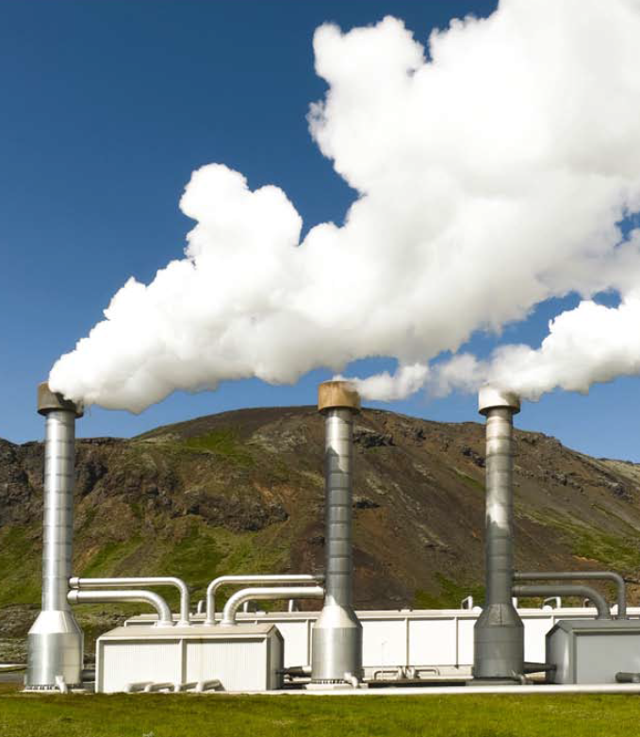
Bilateral Programme CRES - Orkustofnun [2/2]
2. Strengthening research cooperation
    2.1. Visits by CRES staff to Iceland and participation in meetings for the establishment of research collaborations among scientists, engineers, academics and researchers;
    2.2. Participation in an international scientific conference dedicated to renewable energy and geothermal energy.
Budget: €40,000

Slide 23
Thank you for your attention!

