Slide 1
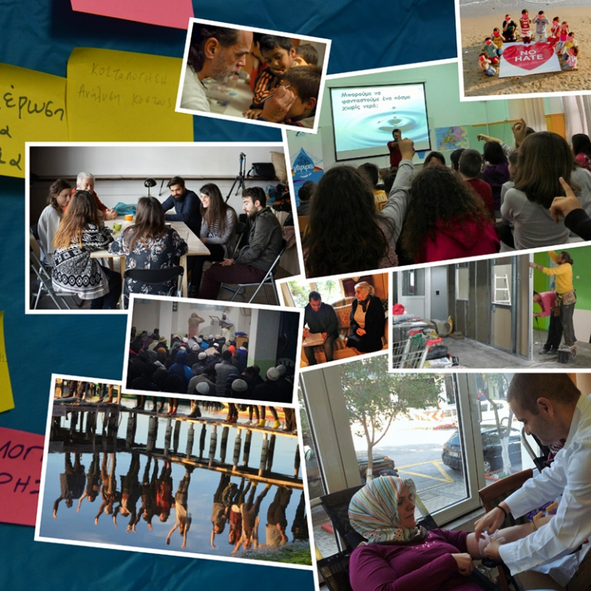
“We are all Citizens”
EEA Grants Financial Mechanism
2009 - 2014
NGO Programme for Greece
@WeRallcitizens
We are All Citizens

Slide 2
The Programme in a nutshell
€ 7,3Μ for the strengthening of the Greek civil society
4 open calls for proposals
76 projects implemented all over Greece
65 project promoters and 40 partners
In total more than 100, 000 beneficiaries

Slide 3
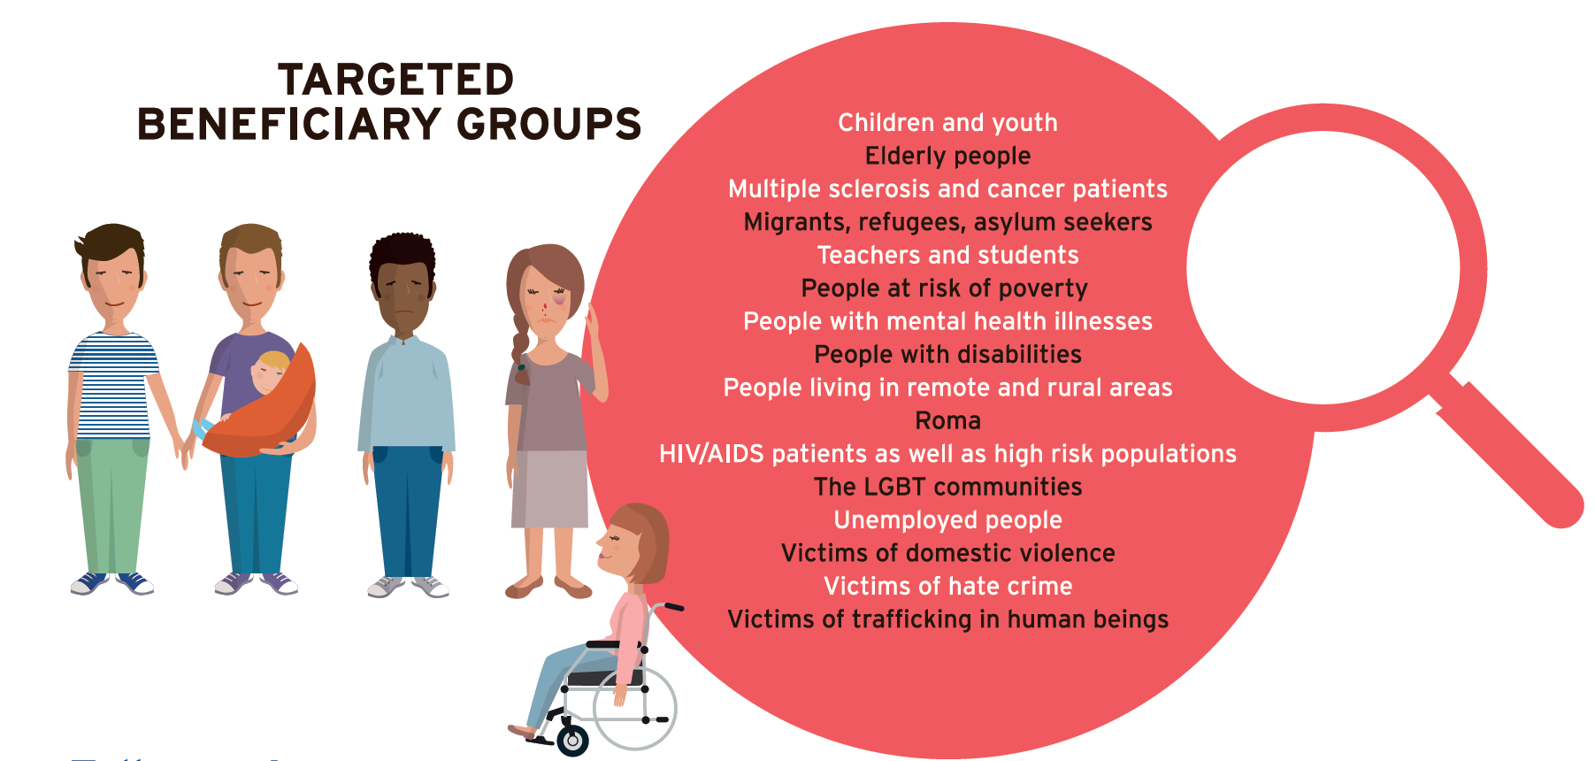

Slide 4
More than €2,9Μ in projects targeting children and youth

Slide 5
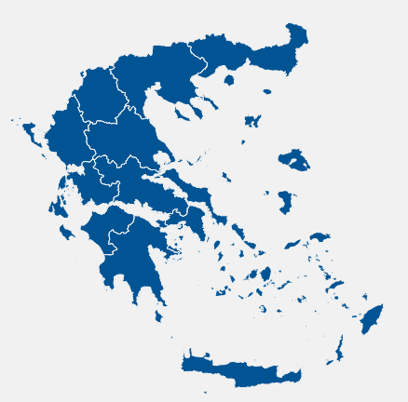
Project’s geographical target
22 projects have a national geographic range of activities
25 projects are being implemented in North Greece
18 projects are being implemented in West Greece
52 projects are being implemented in Central Greece (incl. Attica)
6 projects are being implemented in South Greece
26 projects are being implemented in Aegean

Slide 6
Allocation of funds through transparent processes
Independent scorers/ evaluators
Selection Committee
Steering Committee
571 submitted project proposals
485 eligible proposals
The requested amount was € 54Μ

Slide 7
Progress and financial monitoring is constant & systematic
5 Programme Officers
3 reporting periods per year (progress and financial reporting)
4 reporting periods per year (irregularities reporting)
100% monitoring of financial documents
Specific indicators and targets per project and per thematic area/ call

Slide 8
Open calls
Advocacy and watchdog role: Available funding € 775,350 > Absorption rate 55,58%
Provision of welfare and basic services to defined target groups: Available funding € 2,766,373 > Absorption rate 63,46%
Democratic Values, including Human Rights: Available funding € 1,900,000 > Absorption rate 26,16%
Strengthened capacity of NGOs and an enabling environment for the sector: Available funding € 744,132.96 > Absorption rate 32,39%

Slide 9
Expected Outcome: Advocacy and watchdog role developed (progress until Sept 2015)
Output 1: Increased networking, policy dialogues and consultation projects between NGOs and national/regional/local authorities | Baseline | Interim | Target
Indicator: Number of reports, papers, questionnaires, memoranda and/or petitions prepared for or issued as a result of meetings, policy dialogues and consultation processes. | 14 | 21 | 33
Output 2 : Increased environmental education projects | Baseline | Interim | Target
Indicator: Number of pupils having increased their knowledge on environmental issues. | 1500 | 9155 | 4500
Output 3: Increased awareness-raising projects regarding environmental issues | Baseline | Interim | Target
Indicator: Number of targeted groups (governmental personnel; primary, secondary and tertiary education sectors; general public; etc.) within the scope of these projects who have increased their awareness level regarding environmental issues. | 10 | 117 | 30
Output 4: Increased educational projects promoting the culture of volunteerism and community mobilisation | Baseline | Interim | Target
Indicator: Number of beneficiaries per project. | 200 | 1779 | 400
Output 5: Implemented educational projects promoting social awareness on issues and problems of the socially vulnerable population affected by the Greek crisis | Baseline | Interim | Target
Indicator: Number of beneficiaries per project. | 9000 | 11904 | 17000
Output 6: Increased legal support projects regarding migrants, including undocumented migrants/asylum seekers, and victims of trafficking and/or hate crime | Baseline | Interim | Target
Indicator: Number of beneficiaries who have received legal support. | 6749 | 0 | 7249

Slide 10
Expected Outcome: Provision of welfare and basic services to defined target groups increased (progress until Sept 2015)
Output 1: Implemented projects by NGOs providing basic and welfare services (including medical, mental health, as well as addiction treatment support service) | Baseline | Interim | Target
Indicator: Total number of beneficiaries receiving basic and social welfare services (including medical, mental health, as well as addiction treatment support services per NGO project on a daily rate). | 80 | 11203 | 120
Output 2: Implemented poverty eradication projects by NGOs | Baseline | Interim | Target
Indicator: Number of beneficiaries assisted per social support unit | 0 | 16053 | 60
Output 3: Funded shelter projects providing food, basic services and psychosocial support to homeless people in need | Baseline | Interim | Target
Indicator: Number of shelter beneficiaries having their needs covered on a daily basis | 0 | 13 | 80
Output 4: Increased welfare protection projects for migrants who are victims/ at risk of discrimination, including victims of trafficking, and members of minorities, especially Romani children and women | Baseline | Interim | Target
Indicator: Number of beneficiaries of projects which contribute to increased welfare protection for migrants who are victims/at risk of discrimination, including victims of trafficking, and members of minorities, especially Romani children and women. | 3382 | 2579 | 4742

Slide 11
Expected Outcome: Strengthened capacity of NGOs and an enabling environment for the sector promoted (progress until Sept 2015)
Output 1: Increased training projects on cultural mediation for practitioners, such as the personnel of the First Reception Service | Baseline | Interim | Target
Indicator: Number of practitioners that have improved their cultural mediation skills. | 0 | 36 | 100
Output 2: Increased capacity-building projects for environmental NGOs | Baseline | Interim | Target
Indicator: Number of participants from environmental NGOs who have improved their capacity-building related skills. | 500 | 0 | 1000
Output 3: Implemented capacity-building projects for NGOs that are active in the field of social and welfare services provision, poverty eradication and social inclusion | Baseline | Interim | Target
Indicator: Number of beneficiaries of capacity-building projects for NGOs that are active in the field of social and welfare services provision, poverty eradication and social inclusion. | 0 | 105 | 60
Output 4: Increased capacity-building projects for NGOs and/or other stakeholders promoting democracy, transparency, good governance and citizen participation | Baseline | Interim | Target
Indicator: Number of beneficiaries of capacity-building projects for NGOs and/or other stakeholders promoting democracy, transparency, good governance and citizen participation. | 500 | 37 | 800

Slide 12
Expected Outcome: Democratic Values, including human rights promoted (progress until Sept 2015)
Output 1: Increased concern among NGOs for democratic values, transparency, good governance and citizen participation | Baseline | Interim | Target
Indicator: Number of projects promoting democratic values, transparency, good governance and citizen participation. | 0 | 20 | 30
Output 2 : Enhanced NGO contribution to the horizontal concerns, i.e. hate speech, extremism and hate crime, racism and xenophobia, homophobia, anti-Semitism, tolerance and multicultural understanding, Roma, sexual harassment, violence against women and trafficking | Baseline | Interim | Target
Indicator: Number of projects tackling hate speech, extremism and hate crime, racism and xenophobia, homophobia, anti-Semitism, promoting tolerance and multicultural understanding, the rights of the Roma, the fight against sexual harassment, violence against women and trafficking. | 15 | 20 | 30
Output 3: Increased legal support projects from NGOs for socially vulnerable groups | Baseline | Interim | Target
Indicator: Number of beneficiaries that have received legal support. | 1 | 751 | 25

Slide 13
Bilateral Relations (progress until Sept 2015)
Measure (a) > 33 applications were submitted for funding > 18 initiatives were carried out
Measure (b) (ongoing) > 5 applications were submitted for funding > 2 initiatives were carried out and another 3 have been budgeted.

Slide 14
Bilateral Relations (progress until Sept 2015)
Indicators | Baseline | Interim | Target
Number of project partnership agreements in beneficiary civil society | 0 | 3 | 4
Number of project partnership agreements in the beneficiary private sector | 0 | 0 | 2
Number of project partnership agreements in the beneficiary public sector | 0 | 0 | 1
Number of women involved in exchange visits between beneficiary and donor states | 0 | 76 | 8
Number of men involved in exchange visits between beneficiary and donor states | 0 | 34 | 7

Slide 15
Communication & publicity
1 main launch event in Athens (Acropolis Museum)
7 targeted events all across the country (roadshow)
727 NGO representatives attended these events
More than 350 mentions in press, TV & online media
More than 3,000 e-mails in our database
2 animation videos
More than 2.000 facebook likes
90% positive tone of voice

Slide 16
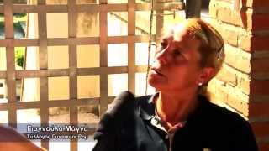
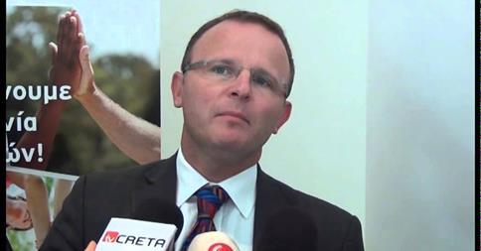
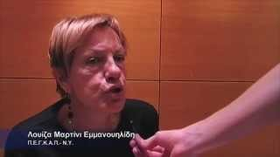
Stakeholders’ testimonies further spread the Programme’s message and key objectives

Slide 17
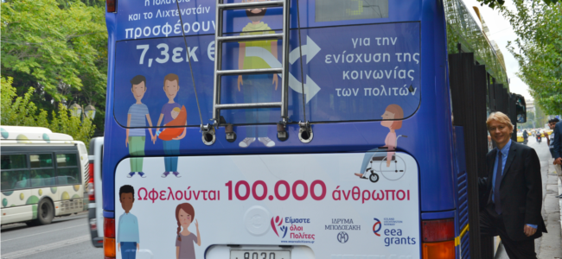
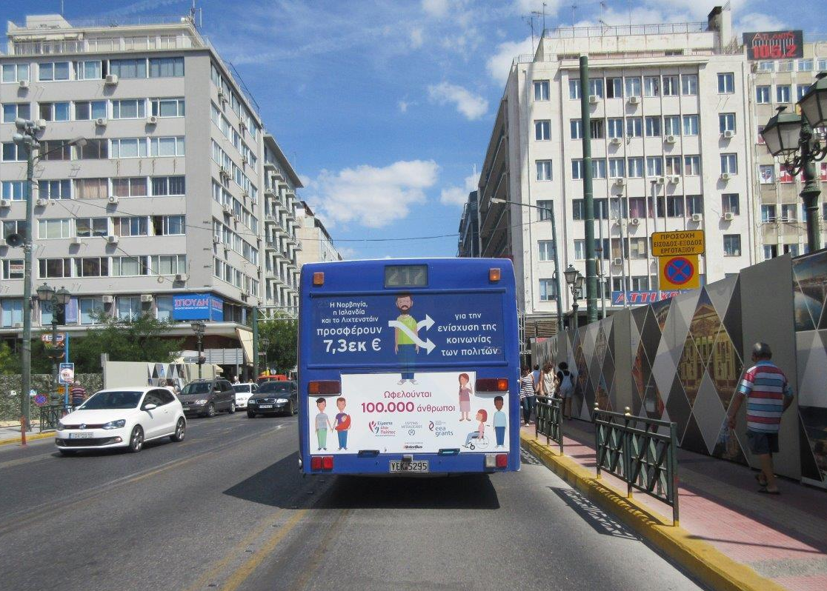
Donor’s recognition campaign

Slide 18
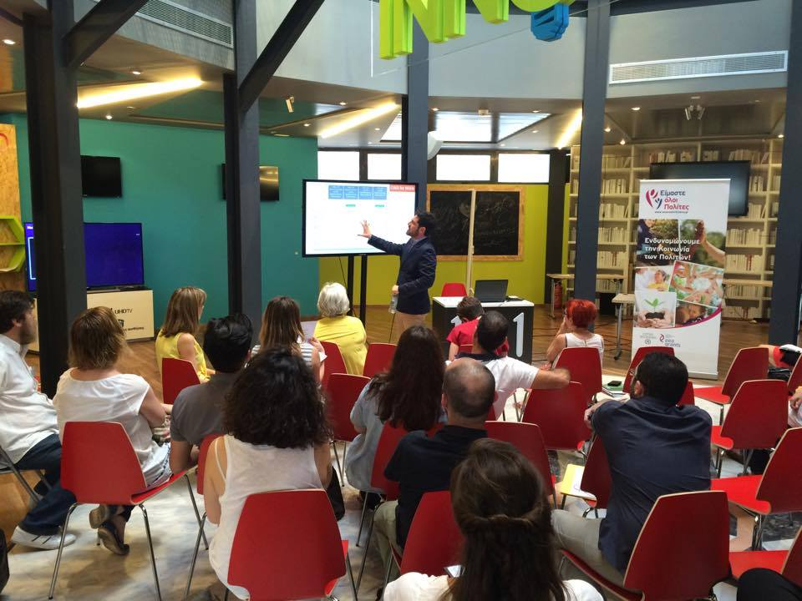
Capacity Building Programme
8 thematic areas / modules
19 educators
120 hours of educational activities/ trainings
14 experienced mentors providing
one-to-one coaching to NGOs
e-learning platform: http://www.ngodynamo.gr/
99% level of satisfaction

Slide 19
Complementary Actions
Communication workshop in cooperation with FMO
Translation of Bookmarks - Combating hate speech online through human rights education
Co-organize Break the Chain Festival to mark the European day against human trafficking
Support ILGA Conference in Athens- Workshop on EEA Grants contribution to a sustainable and empowered LGBT community across Europe
CB workshop next year

Slide 20
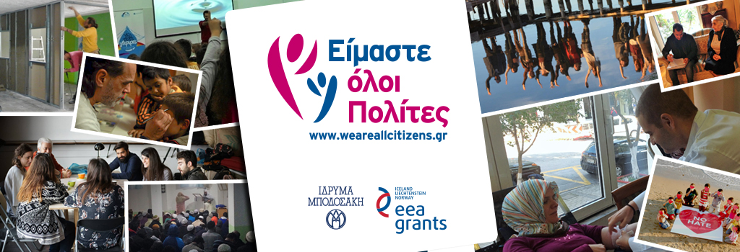
Thank you!

